Slide 1
Zero Trust
Layman’s Terms Concept Of Zero Trust

Slide 2
Data Breach
A data breach occurs when attackers obtain illegal access to a computer system or network, resulting in the loss of private, sensitive, or confidential personal and financial data held inside.
Common cyber attacks used in data breaches are:
Ransomware
Malware
Phishing
Denial of Service

Slide 3
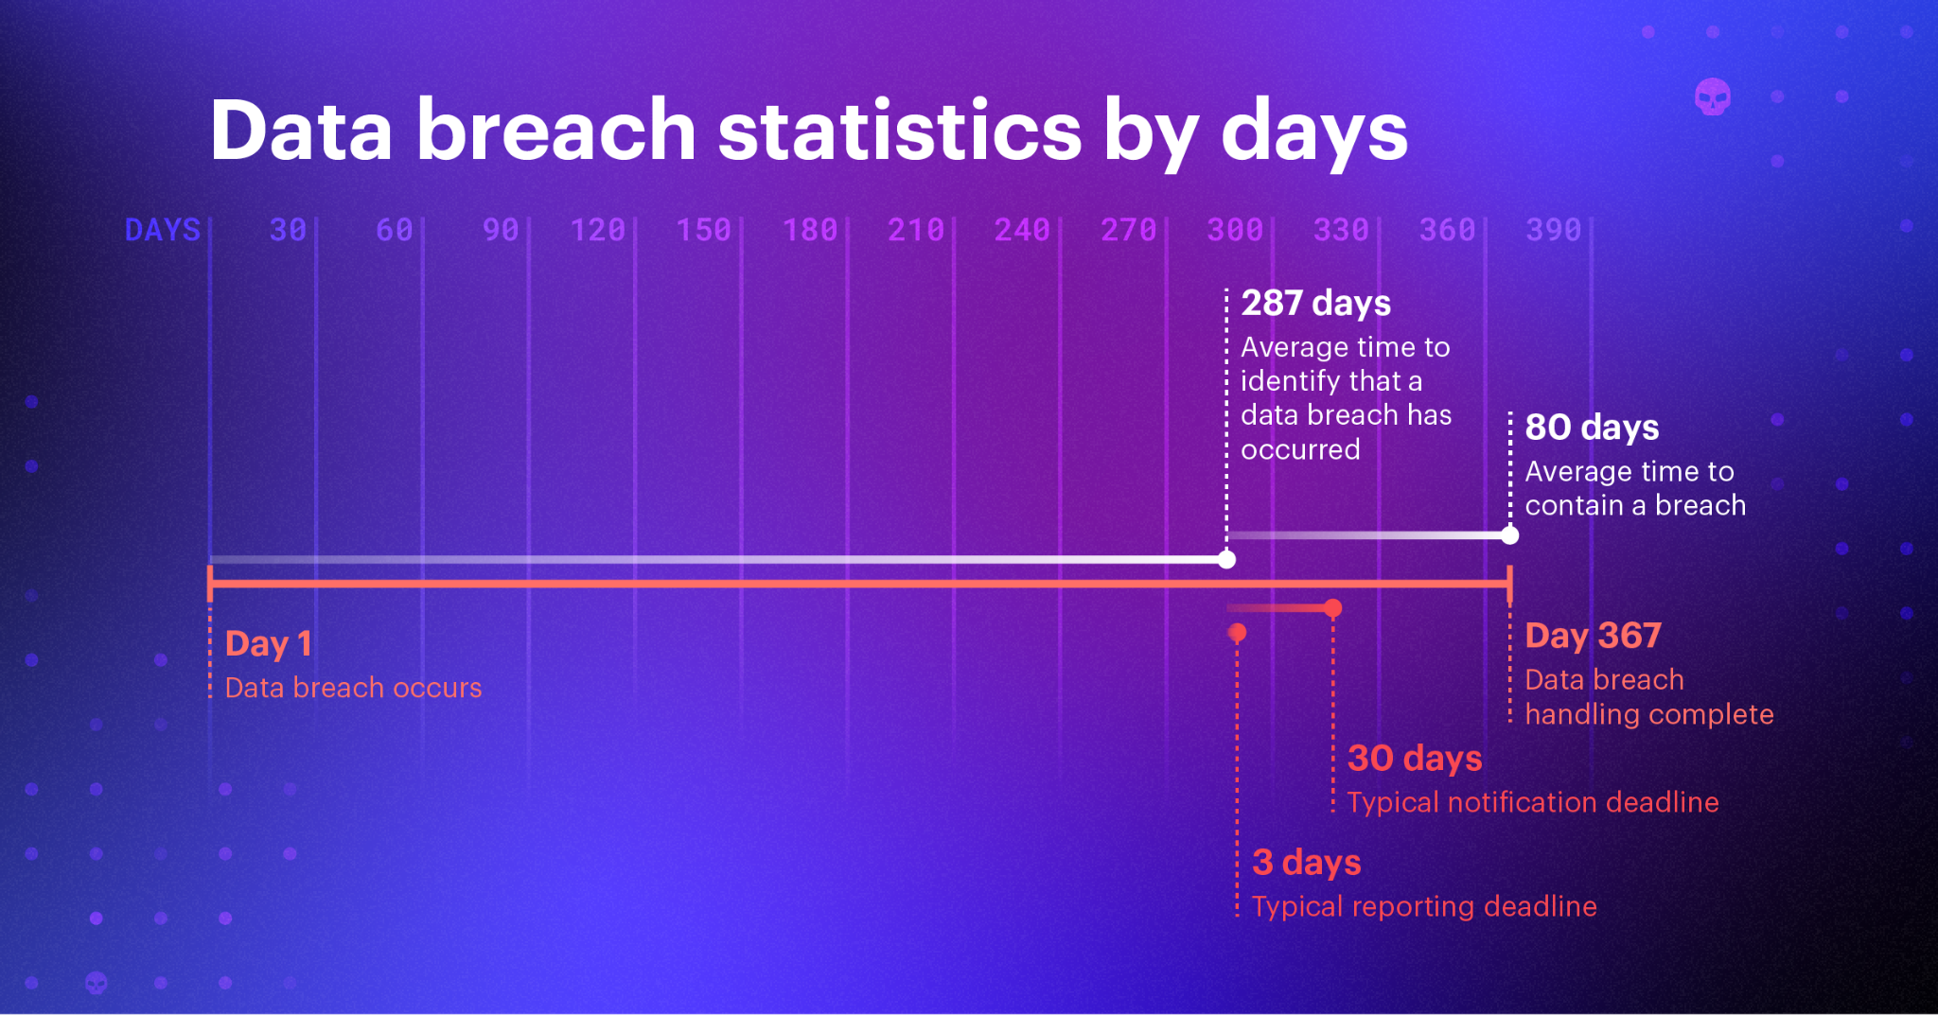
How Many Data Breaches Occur?
The Privacy Rights Clearinghouse keeps a chronology of data and public security breaches dating back to 2005.The actual number of data breaches is not known.The Privacy rights Clearinghouse estimated that there have been 9,044 public breaches since 2005, however more can be presumed since the organization does not report on breaches where the number of compromised records is unknown .

Slide 4
Multi-Factor Authentication, Role, And Attribute- Based Access
Multi-factor authentication (MFA) is an aspect of IAM that demands users to submit more than one form of identification when attempting to access a system. By making it more difficult for attackers to get access to your system, MFA can increase security. For example, with tool Duo You'll login as usual with your username and password, and then use your device to verify that it's you all setup by your administrator Duo Mobile smartphone app, SMS, voice call, one-time passcode.
Because there are no passwords or rotating codes to mistakenly reveal to an attacker, the FIDO2 security structure eliminates the hazards of phishing, all forms of password theft, and replay assaults. The credentials are unique to each website, they never leave the user's possession, and they are never kept on a server.

Slide 5
Zero Trust, Audit & Compliance: Joining The Dots
Zero trust supports the IT staff by guaranteeing watertight security and preventing breaches. Zero trust supports auditors in demonstrating your data management and data protection practices.
Many requirements require enterprises to provide documentation of data collection, use, and storage in order to comply. Because a zero-trust framework necessitates robust asset identification and data mapping, it can provide critical assurance to auditors about the data in the company's systems where it is housed, and what apps or devices have access to it.

